Slide 1
1st Summer course
24/05/2024
Tomas Mickevičius
Vytautas Magnus University

Slide 2
T4EU Summer Course
What? ‘(CO)HAPPINESS LABORATORY’
Summer course
When? August 27 to 29, 2024
Where? Kaunas, Lithuania
Target group? BA and MA students
Why? Because its awesome ☺

Slide 3
‘(CO)HAPPINESS LABORATORY’
Concept - the course will focus on shaping conditions for the happiness of oneself, and us all as a society in times of challenges and transformations
Format - Hackathon
Interdisciplinary course: psychology, philosophy, economy, neuroscience, anthropology, political sciences, etc
Cultural and social activities
∞ adventures

Slide 4
TENTATIVE PROGRAMME
Monday, August 26 | Arrival Welcoming event
Tuesday, August 27 | Happiness for myself: “To be or not to be happy” “Happiness signals in my body and brain” “The more mindful and resilient, the happier” “Buying your happiness” Visit to the VMU Botanical Garden for relaxation practice
Wednesday, August 28 | Happiness for others: “Happiness is about helping others” “How to encourage growth mindset” “Leading for happiness” Creative walk on Freedom Avenue – seeing the happiness of others through the lens
Thursday, August 29 | Happiness for us: “Different but happy” “Political design for happiness” “The power of social connection” Having fun with Lithuanian Folk dances Presentation of group proposals to a panel of judges
Friday, August 30 | Departure

Slide 5
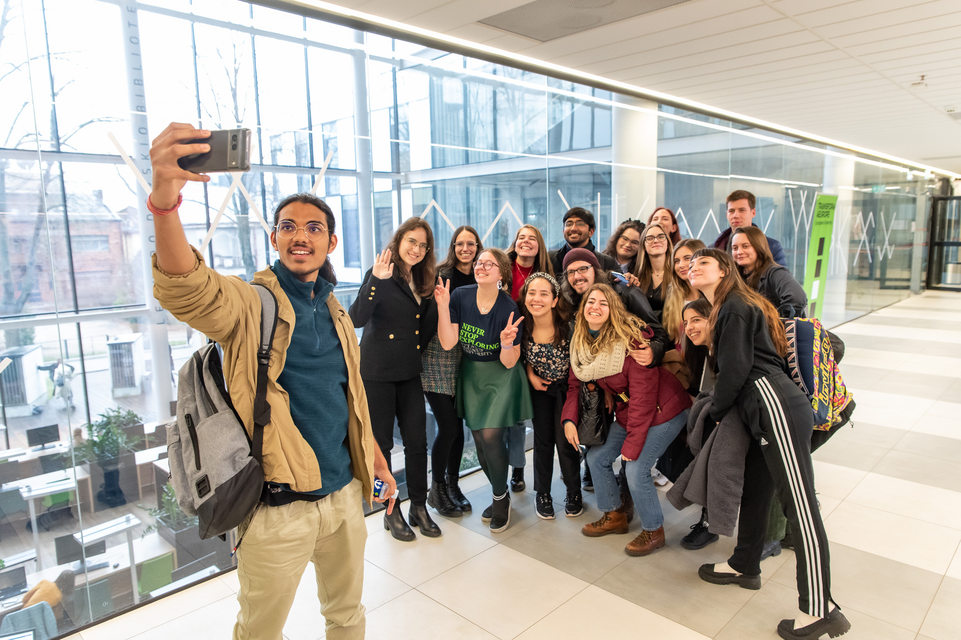
Facts and figures
3 students per partner (30 in total)
3 ECTS for students
June 30th application deadline (?)
Student Mobilities funded by T4EU funds
Guest lecturers wanted

Slide 6
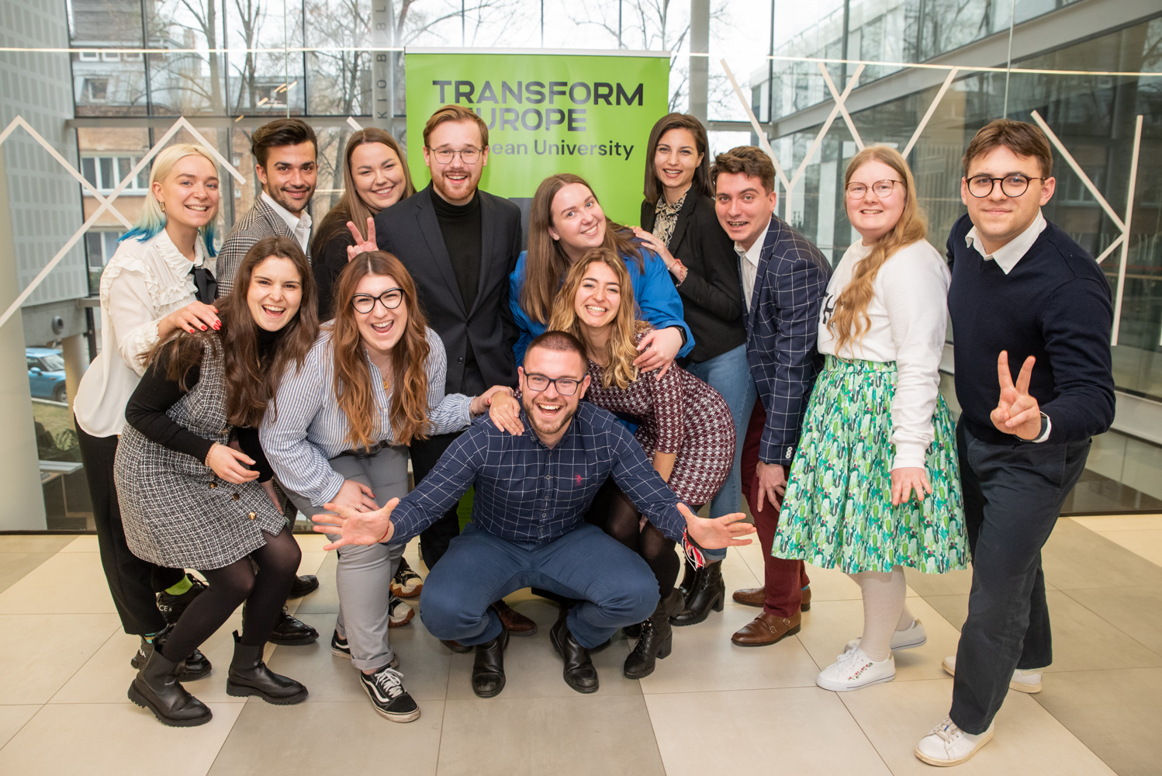
Q&A

Slide 7
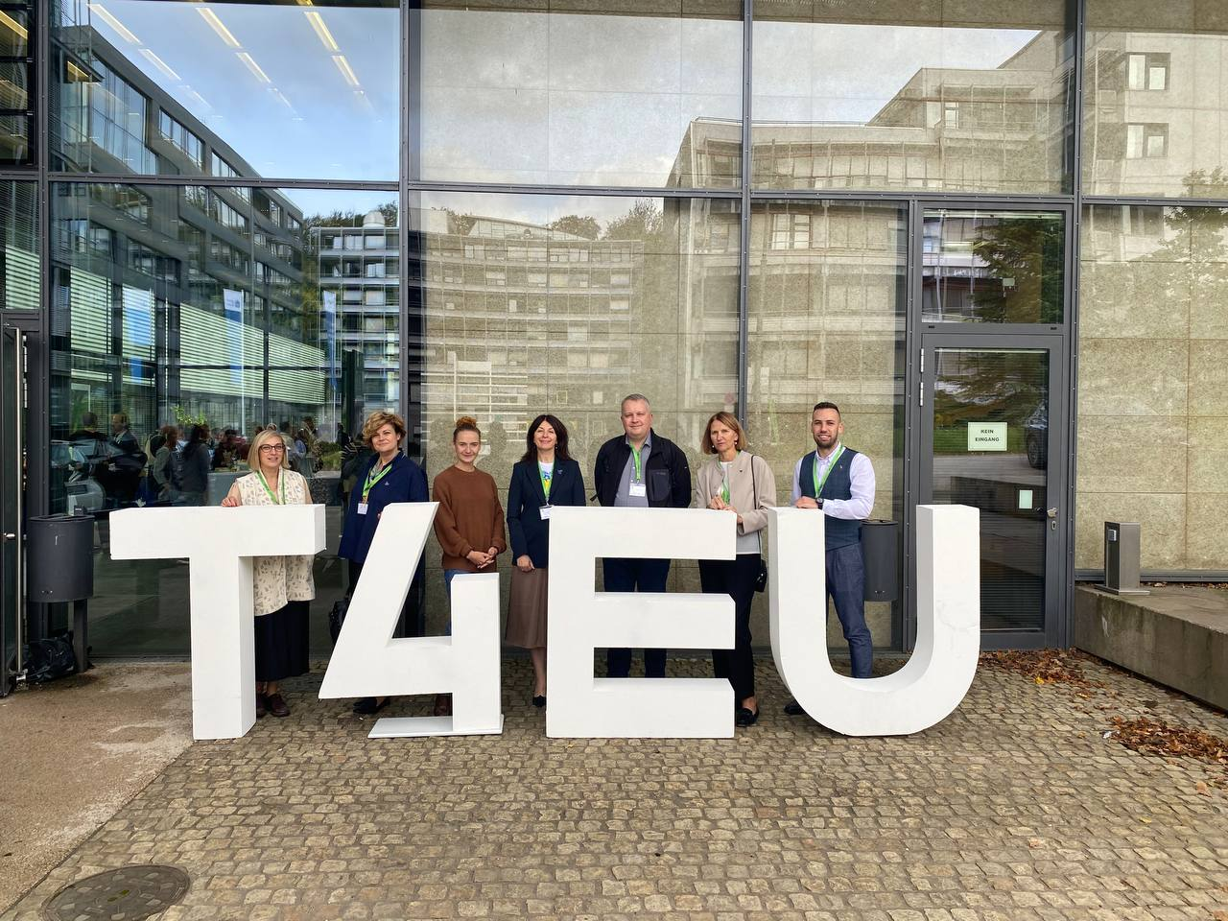
Thank you!
Keep track of upcoming events and the latest programme calls:
Transform4Europe
Transform4Europe
Transform4europe.eu

